Slide 1
FARMER’S QUORA
Team Members:
Dharsana V. - 20C019
Lokesh D. - 20C049
Madhu Priya Dharshini S. - 20C050

Slide 2

INTRODUCTION OF MONGODB:
MongoDB is an open source NoSQL database management program.
Scalable high-performance Open-source,Document oriented database.
Built for speed.
Rich document based queries for Easy readability.
Replication and failover for High Availability.
Auto sharding for Easy Scalability.

Slide 3


LICENSES OF THE TOOL
Server Side Public License (SSPL)- for all versions after Oct 16, 2018
Free Software Foundation’s GNU AGPL v3.0 (for all versions)
Mongodb.org supported drivers - Apache License v2.0

Slide 4


ALTERNATIVES FOR THE TOOL
1.Apache Cassandra
Supports Replication across many data centers and cloud availability zones, created by Facebook for their deployment
Issues - Availability issues ,unpredictable performance
2.Redis
Built-in search capabilities and a linearly scaling high performance and its extremely fast
Issues - Pricing

Slide 5
ADVANTAGES OF USING THE TOOL
Simple Installation
Cost-effective
Widely supported and code-native data access
Powerful querying and analytics
Schema less document database that holds different database
Structure of single object is clear
No complex joins
High speed and higher availability

Slide 6

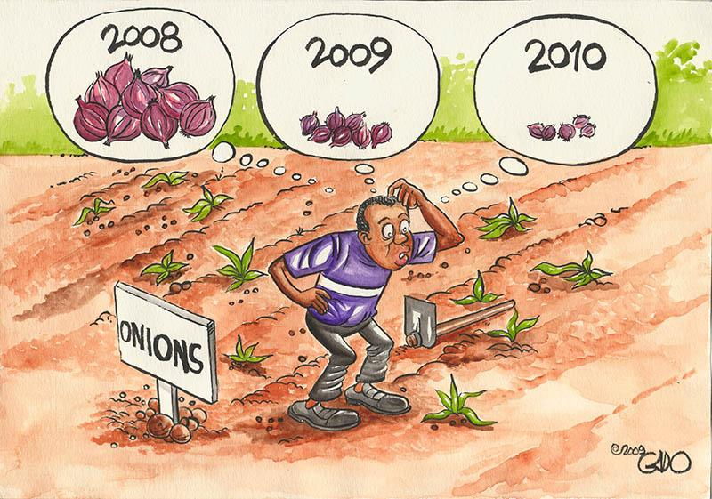


PROBLEM STATEMENT:
To develop a web portal where farmers can post their queries regarding plant diseases, pest management and weed control and receive advice from professionals
PROBLEM DESCRIPTION:
Agriculture struggles to feed the rapidly growing global population due to increasing plant diseases
It lowers the quality & quantity of food crops.
Prevention can be achieved with adequate technical support.
A community based web portal ,where farmers can upload photographs or describe about the disease affected plants and get instantaneous solutions from experts.
Farmer’s query and expert’s solutions will be stored in the no relational database called MongoDB
=

